Slide 1
Data Analysis of Social Media Sentiment in the COVID-19 Crisis
Hannah Abraham, Kashvi Lalgudi, Ashna Wadhwa, Cara Dong, Randy Shee
Notes:
H

Slide 2
OUR EVOLUTION
-Had to choose dataset of tweets for 1 day of the outbreak
-Trouble finding words that showed significant patterns
-Pivoted to analyzing most common words
-Analyzed dataset of tweets on March 17th, 2020
-Created a word cloud to visualize the frequency of words in the tweets
OG Plan
Execution
NOW
- Get Dataset of Tweets over the course of the COVID-19 outbreak
-Analyze tweets for patterns of disbelief or panic words used
-Show progression of these patterns over time
Pivot
-Selected the relevant columns (text and language)
-Created program to get the most frequently used word for each tweet
-Generated word cloud for show frequent words
Notes:
H

Slide 3
Information About Data
Kaggle Link https://www.kaggle.com/smid80/coronavirus-covid19-tweets
Used one data set
65,535 Tweets (that could be opened)
Tweets from March 17, 2020
Columns used
Language column
Text column
Stop words utilized for Word Cloud
Notes:
H

Slide 4
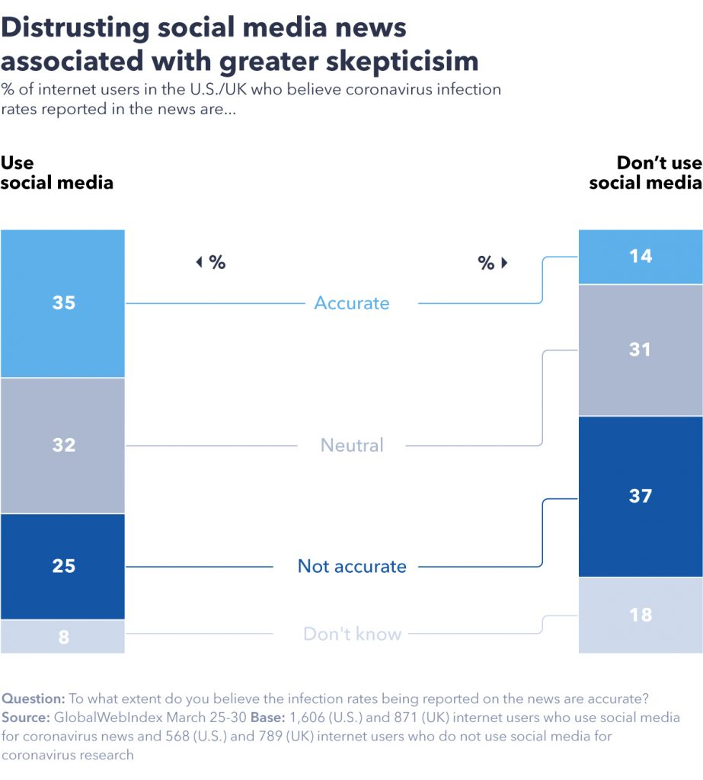
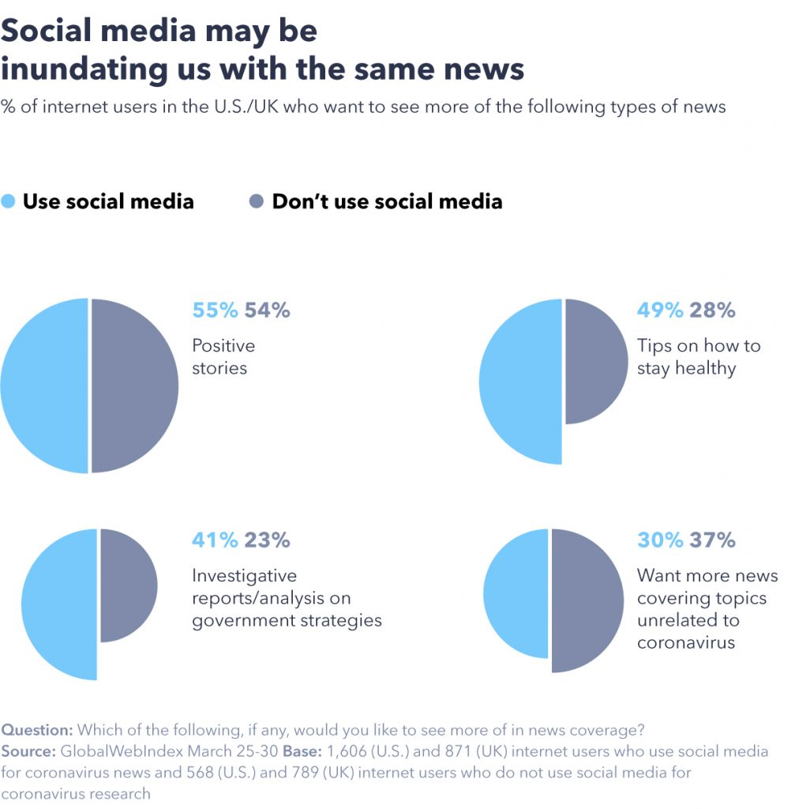
Relevance/ Why is this important?
Notes:
H

Slide 5
Visualization Explanation
Creating dataframe
Taking appropriate column
Filtering by the selected column
Setting stopwords
Making the Word Cloud
Notes:
A

Slide 6
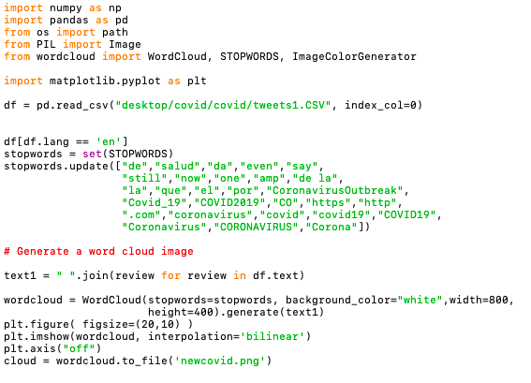
Notes:
A

Slide 7
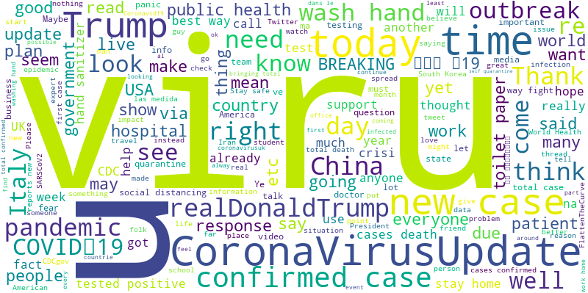
Notes:
A

Slide 8
Analysis
Prominent words:
Virus (viru)
Trump
realDonaldTrump (Trump’s twitter handle)
Country names
Negative words like “fake” do not appear in this set
Possible reasoning: on social media platforms like Twitter, users are working hard to make sure people understand the urgency of the COVID crisis
Notes:
A

Slide 9
Obstacles
Issues loading the dataset
Initial column we planned to use was not a part of the dataset
Not all of the columns could be accessed
Parts of the data were not up-to-date (March)
Filtering data (not completely thorough)
Parts of the data was mislabeled
Basic unfamiliarity with versatility of Word Cloud
Notes:
K

Slide 10
The Data Science Life Cycle
Identify the question to solve a problem - Identify most common words in tweets
Find relevant data - we used a dataset from kaggle
Prep the data(data cleaning)- selecting relevant columns
Explore the data to pull out important findings
Visualize the data- Word Cloud
Communicate the findings and conclusion
Notes:
K

Slide 11
Project Follow-Up
Become more familiar with the tools
Be successful in combining data sets together
Frequency will change
Specifically target panic words
See how location impacts what people are saying on social media
Use a different data where we collect the most recent tweets/posts
Correlate age with the amount of panic words in tweets to better understand our demographic.
Notes:
K

Slide 12
Huge Thank You To Safwan Masood and DSS!

